Slide 1
CALCIUM DEFICIENCY IN WOMEN
DR.RASHMI MINJ
PROF./DEAN. GOVT.D.B.GIRLS’P.G.COLLEGE, RAIPUR

Slide 2

Calcium deficiency is mainly due to inadequate supply of Ca from food or failure of absorption of Ca in the body. .Repeated pregnancy and Lactation with inadequate Calcium supply from food source the Indian women specially who belongs to Low socio income group are the sufferers of Ca deficiency

Slide 3
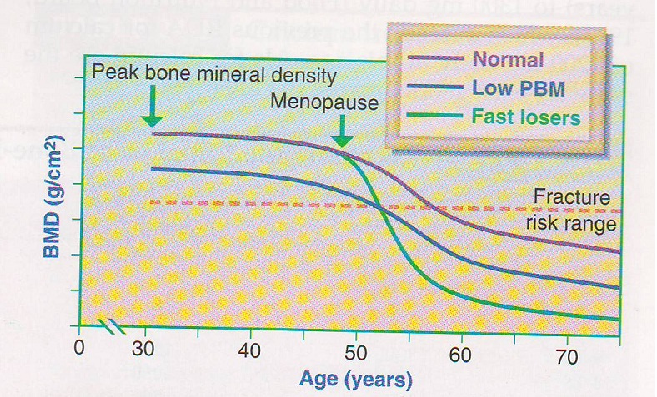
Peak Bone Mass is reached by 30 years of age or soon thereafter. At this time bone tries to deposit Calcium as much as possible. During pregnancy due to excessive demand it is difficult to retain Ca into the bone. From here, if Ca supply is not sufficient problem arises and it may leads to Low Bone Mass.

Slide 4
Groups at Risk of Calcium Inadequacy
Dietary intakes of the calcium below recommended levels might have negative health consequences over the long term. The following groups are among those most likely to need extra calcium.
Osteoporosis prevention begins in childhood by maximizing Calcium retention and bone density in growing years.

Slide 5
It is most efficient during childhood & adolescence when bones are growing rapidly and are most sensitive to environmental influences such as diet, physical activity. Recent food consumption survey shows children are drinking more soft drink, non-citrus juices and less milk. Education is needed to encourage young people to consume appropriate amount of Calcium from food sources.

Slide 6
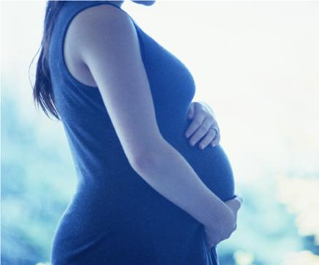
Pregnancy &lactation
All women need calcium to protect their bones. In pregnancy, calcium intake is particularly important. A fetus's growing skeleton requires a lot of calcium, and the baby takes its necessary nutrients from its mother, particularly during the last trimester. If the mother doesn't get enough calcium from her diet or from supplements, this can create health problems and potentially put her bones at risk.

Slide 7
An adequate intake of calcium during pregnancy can help women avoid preeclampsia. If preeclampsia develops, a woman develops high blood pressure and excess protein in the urine late in her pregnancy. Untreated, preeclampsia decreases blood flow to the fetus, which can result in preterm birth and/or low birth weight.

Slide 8
Postmenopausal women
Menopause leads to bone loss because decrease in estrogen production increases bone resorption and decrease calcium absorption . Annual decrease in bone mass of 3%–5% per year frequently occur in the first years of menopause, but the decreases are typically less than 1% per year after age 65 . Increased calcium intakes during menopause do not completely offset this bone loss . Estrogen therapy restores postmenopausal bone remodeling to the same levels as at pre menopause, leading to lower rates of bone loss , perhaps in part by increasing calcium absorption in the gut.

Slide 9
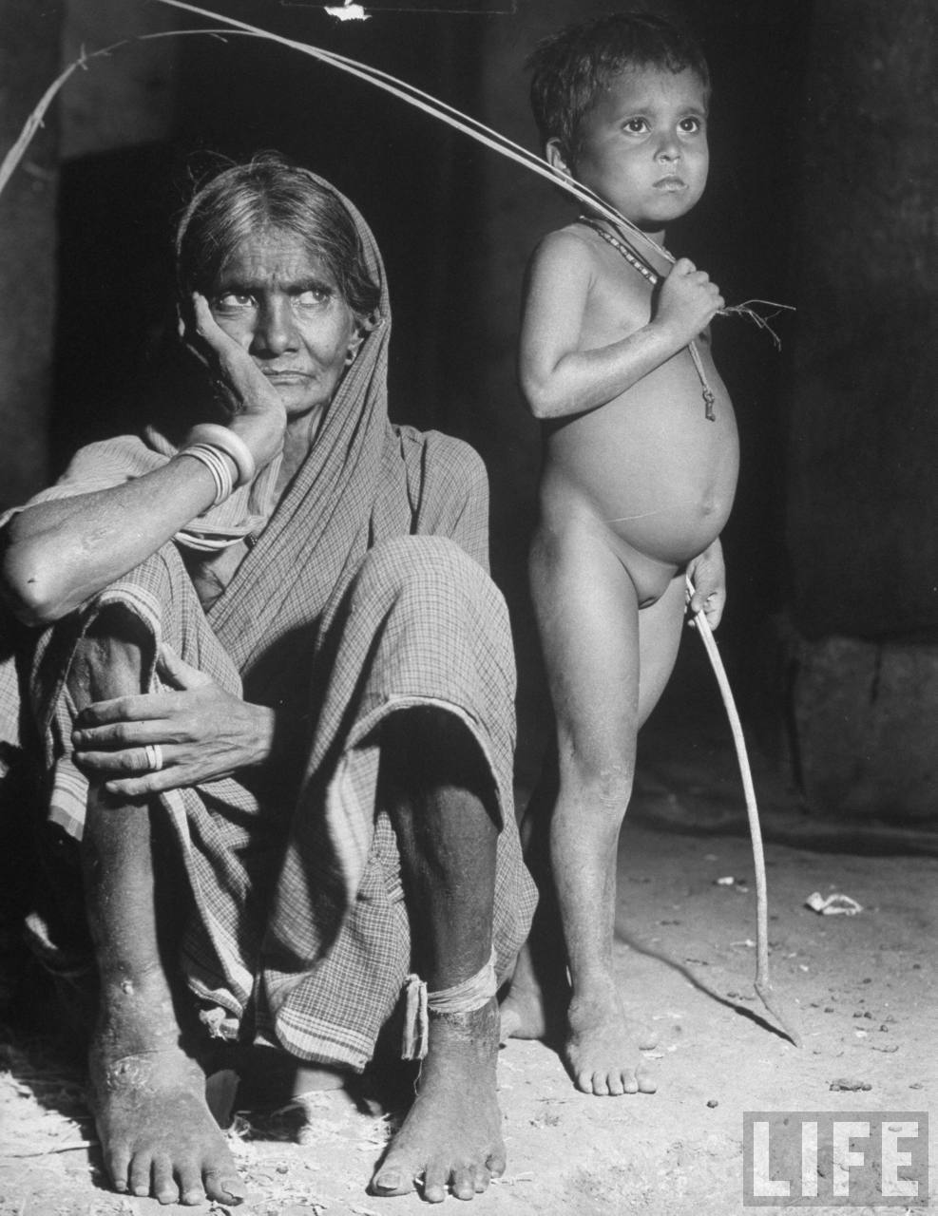

Postmenopausal women

Slide 10
Amenorrheic women
Amenorrhea, the condition in which menstrual periods stop or fail to initiate in women of childbearing age, results from reduced circulating estrogen levels that, in turn, have a negative effect on calcium balance. Amenorrheic women with anorexia nervosa have decreased calcium absorption and higher urinary calcium excretion rates, as well as a lower rate of bone formation than healthy women

Slide 11

Amenorrheic women

Slide 12
The "female athlete triad"
The "female athlete triad" refers to the combination of disordered eating, amenorrhea, and osteoporosis. Exercise-induced amenorrhea generally results in decreased bone mass . In female athletes and active women in the military, low bone-mineral density, menstrual irregularities, certain dietary patterns, and a history of prior stress fractures are associated with an increased risk of future stress fractures . Such women should be advised to consume adequate amounts of calcium.

Slide 13
Individuals with lactose intolerance or cow's milk allergy
Lactose intolerance refers to symptoms such as bloating, flatulence, and diarrhea that occur when one consumes more lactose, the naturally occurring sugar in milk, than the enzyme lactase produced by the small intestine can hydrolyze into its component monosaccharide's, glucose and galactose

Slide 14
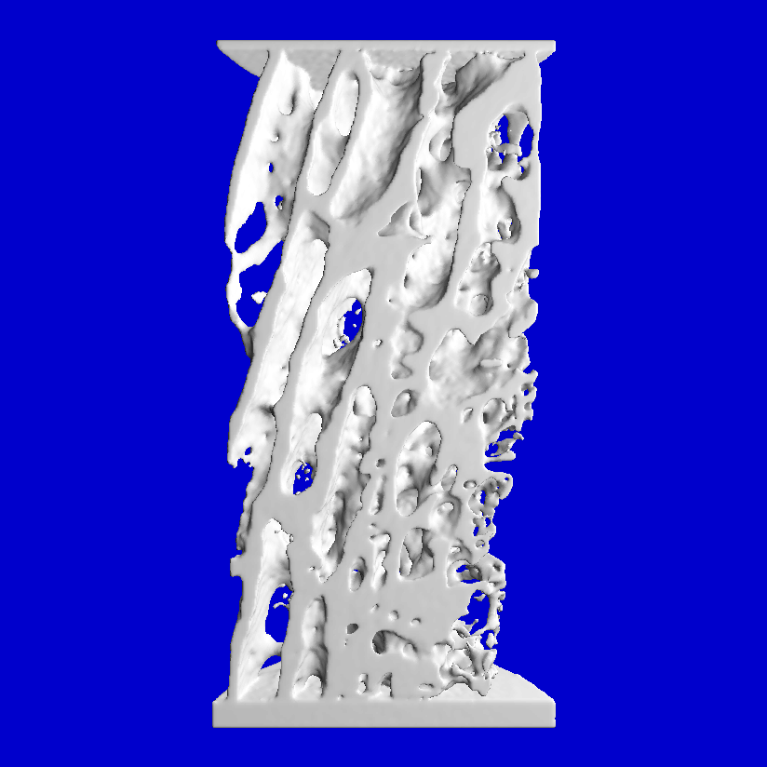
Calcium is the most abounded mineral in the human body and performs several important function. Ca is a top macro mineral, which helps to built our skeleton and bone strong.

Slide 15
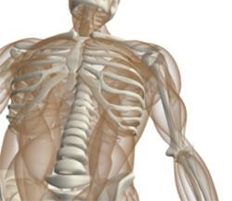
Functions…….
It is require for-
Vasodialation,
Vascular contraction,
Muscle function,
Nerve transmission,
Hormonal secretion
Blood clotting.
Although less than 1% of the
total Ca is required for these
critical metabolic processes.

Slide 16
Because of its biological importance, Ca levels are very carefully controlled in various compartment of body. The major regulators of blood calcium are parathyroid, Vit.’D’ and Calcitonin PTH normally released from 4 parathyroid gland in response to low Calcium levels in the blood stream, that is Hypocalcemia.
PTH acts in three major ways (1) It causes bone to release some of its Ca store, (2) It increases the absorption of Ca in gastro-intestinal tract, (3) it causes kidney to excrete more phosphorus which indirectly raise the Ca levels.

Slide 17
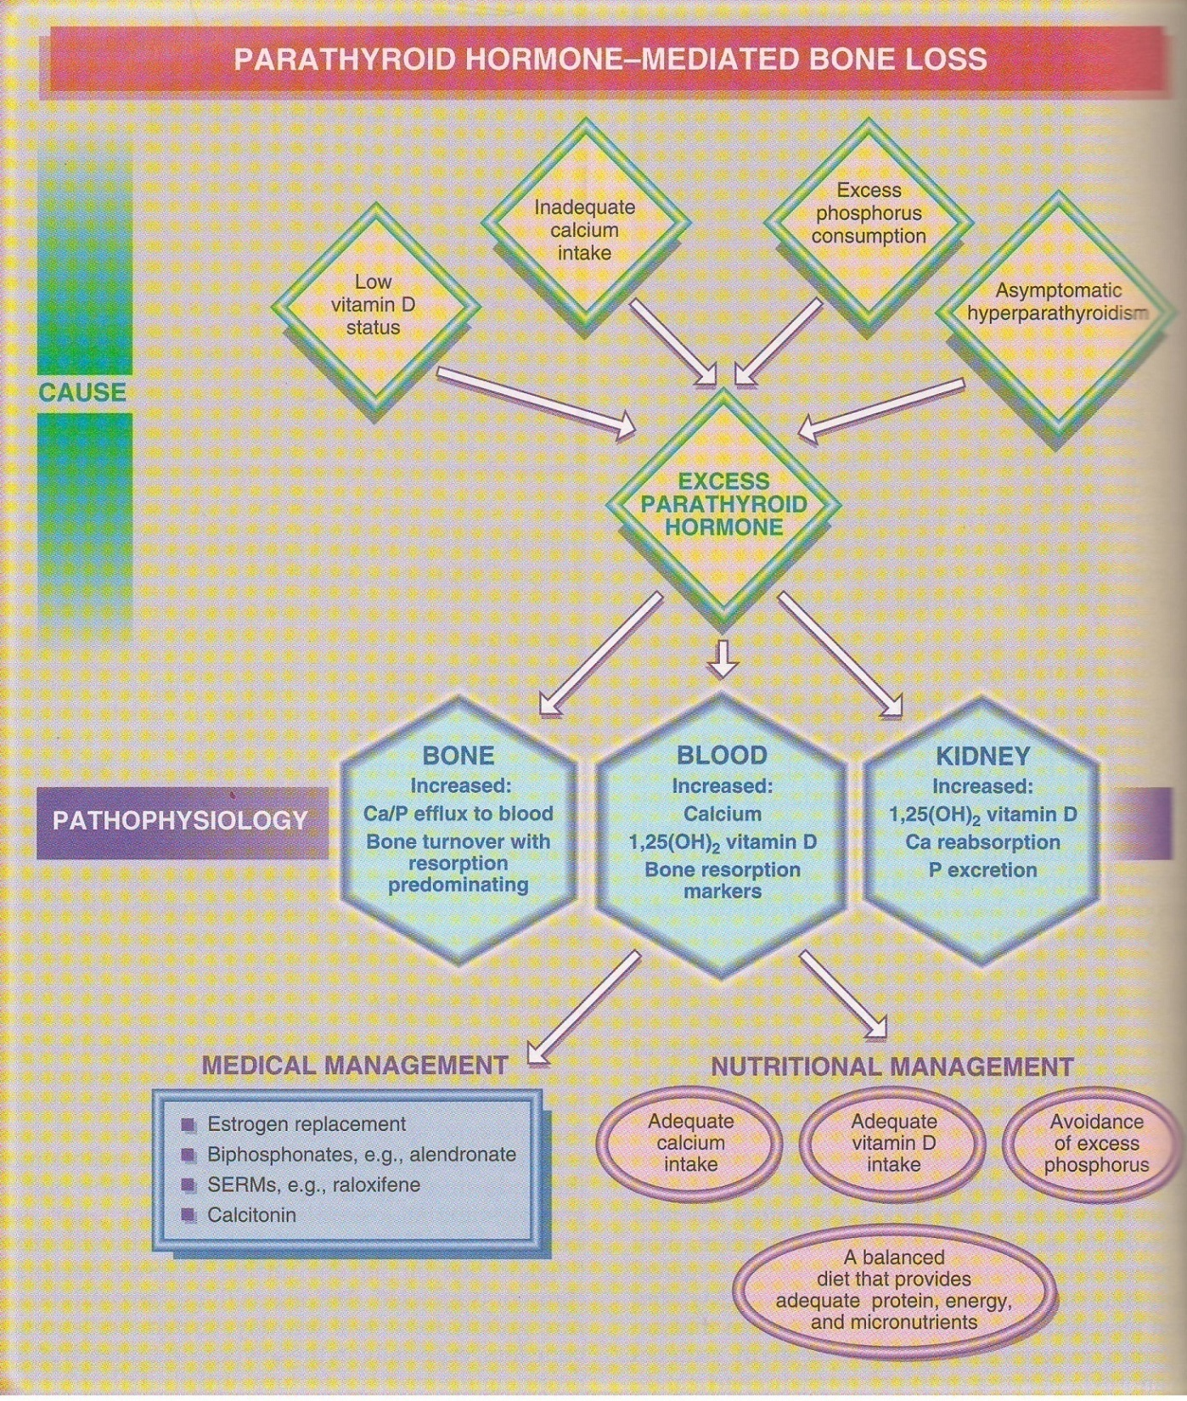

Slide 18
Vit. ’D’ works together with PTH in bone and kidney. It is also necessary for the intestinal absorption of Ca from food sources. Vit.D can obtain either from food or produced in skin with the help of ultraviolet rays. Insufficient Vit.D With Ca deficient diet may leads to Rickets in children, Ostromalacia in adult and Osteoporosis in Elderely , Calcitonin is the hormone released by thyroid, parathyroid, the thymus glands, lowers the blood levels by promoting the deposition of Ca into bone.

Slide 19
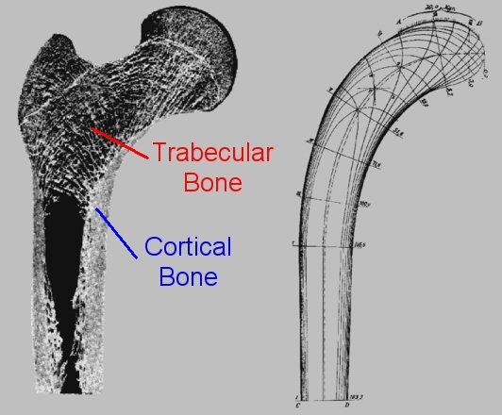
The body uses Calcium from bone tissue as reservoir and source of Ca to maintain the constant concentration of Ca in blood, muscles and intracellular fluid.

Slide 20
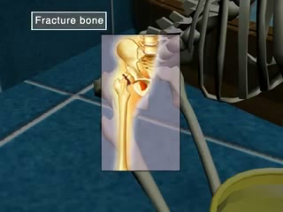
The remaining 99% of the Ca is stored in bone and teeth, where they support their function and structure. Bone itself undergoes continuous remodeling with constant re-absorption and absorption of Ca into the new bone. The balance between both processes changes with age.

Slide 21
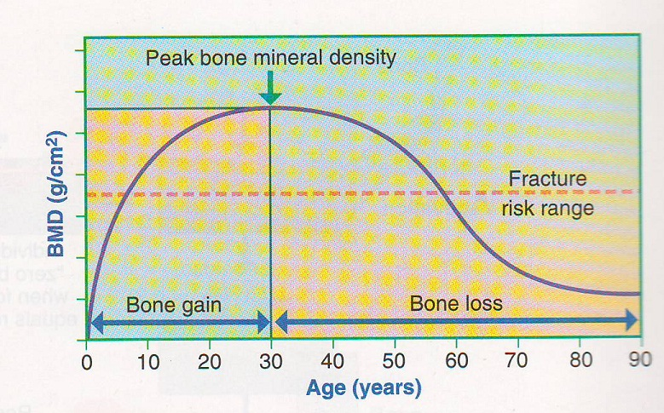
Bone formation exceed bone re-absorption in the period of growth in children and adolescents, where as in early and middle adulthood both the process are relatively equal .In Aging particular among post menopausal women the bone breakdown exceeds bone formation, resulting in bone loss that increases the risk of Osteoporosis.

Slide 22
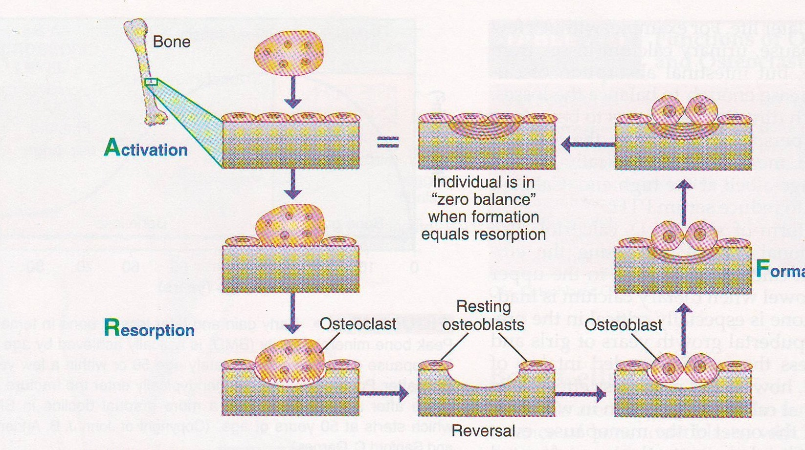

Slide 23
.. Not all calcium consumed is actually absorbed in the gut. Humans absorb about 30% to 35% of the calcium in foods, but this varies depending upon the type of food consumed . Net calcium absorption is as high as 60% in infants and young children, who need substantial amounts of the mineral to build bone . Absorption decreases to 15%–20% in adulthood (though it is increased during pregnancy) and continues to decrease as people age; compared with younger adults, recommended calcium intakes should be higher for females older than 50 years and for both males and females older than 70 years

Slide 24
)
Absorption of dietary calcium = 35% of intake (higher at low intakes, lower at high intakes
75% of daily needs from milk and milk products
Smaller amounts from vegetable sources
Favors absorption:
Infancy, adolescence,
pregnancy
High calcium phosphate
ratio (breast vs cow milk)
Impede absorption:
Low calcium phosphate
ratio
Phytate, oxalate present
Vitamin D deficiency

Slide 25
Many factors influence calcium absorption, among them lifestyle, exercise, dietary intake, and pH balance of the gastrointestinal tract.
Effective calcium absorption begins in the stomach. If the stomach produces too little stomach acid (hydrochloric acid), calcium remains insoluble and cannot be ionized, which is necessary for it to be assimilated in the intestines.

Slide 26
HCL in Stomach
The proper level of hydrochloric acid in the stomach is so important that its lack in the digestive process can account for as much as 80 percent loss of available calcium absorption. Studies show stomach acid secretion decreases with age, and, "up to 40 percent of post-menopausal women may be severely deficient in this natural stomach acid."

Slide 27
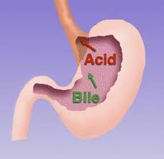
Factors leading to reduced stomach acid include a diet of over-cooked, over-processed, lifeless foods which no longer contain naturally occurring enzyme activity, as well as the excess consumption of antacid medications.

Slide 28
Poor intestinal health such as Crohn's disease, Irritable bowel syndrome and Ulcerative colitis experience.
Mineral imbalance with phosphorus might be caused by an over consumption of high phosphorus foods like meats, processed snack foods .Excessive phosphorus intake as phosphate Can greatly impaired the Ca :P level .Specially when Ca intake is low.

Slide 29

Caffeine, which can bind with calcium and through its natural diuretic action, increase the excretion of calcium.
1 cup of regular coffee for example causes a loss of only 2-3 mg. of calcium . Moderate caffeine consumption 1 cup Coffee or 2 cup tea/day in young women has no negative effects on bone ,but more than that can modestly increase calcium excretion and reduce absorption. Coffee reduces inositol levels in the blood. Inositol is a regulating factor in calcium metabolism. It inhibits formation of the cells (osteoclasts) that draw calcium from the bones into the bloodstream .

Slide 30
Vitamin D
It is required for intestinal calcium absorption, reduced vitamin D levels are common in elderly individuals, especially women. Factors that can affect vitamin D levels include reduced exposure to sunlight, decreased dietary intake and absorption problems. Supplementation of vitamin D daily, as part of a full spectrum formula, should be adequate for most people. An excess of this vitamin has not shown an increased benefit. The body's use of vitamin D is enhanced in the presence of magnesium and boron.

Slide 31
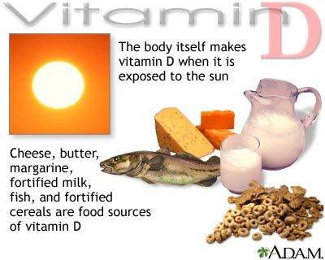

Slide 32
ROLE OF ESTROGEN-
"A lack of estrogen in post-menopausal women prevents the absorption and utilization of calcium and is the single most important factor in the development of osteoporosis in older women.“
Although ERT can reduce the risk of osteoporosis if taken within three to five years after menopause, taking it also entails increased risk for some kinds of cancer, heart disease and gall bladder disease. Less serious side effects of imbalanced ERT therapy can include enlarged and tender breasts, nausea, skin discoloration, water retention, weight gain, headaches, and digestive problems .
While estrogen if administered properly ,can prevent further bone depletion, it does not replace bone that has already been lost .The only way to regain the bone los is through proper nutritional support with aggressive dietary supplementation.

Slide 33
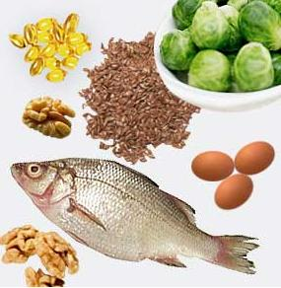
Magnesium: Is responsible for many biochemical processes within the bone. Magnesium is essential for the conversion of vitamin D to its biologically active form.
Manganese: This trace mineral is essential for the mineralization of the bones as well as the production of cartilage and connective tissues. The best source of manganese in the diet is from grains but as much as 75 percent of all manganese is lost in the refining of wheat to white flour.

Slide 34
Zinc: This vital trace mineral is essential for normal bone formation and is involved in the biochemical activities of vitamin D. Dietary surveys consistently indicate that as many as 70 percent of all Americans consume less than two-thirds of the RDI for zinc.
Boron: Small amounts of this trace element can greatly enhance the absorption of calcium via a positive effect upon the hormone levels of the body. It is estimated that 1 to 2 mg per day is adequate for this mineral.

Slide 35
PROTEIN
Some studies show that diets that are high in protein, especially animal protein, do cause increased losses of calcium in the urine and may even in-crease fracture risk . These effects of protein may be especially important in those with low calcium intakes . Other studies suggest that a higher protein intake is needed to promote calcium absorption , reduce the risk of fracture , and increase bone density . Until further evidence is available, vegans should strive to meet calcium recommendations and to have adequate, but not excessive, amounts of protein.

Slide 36
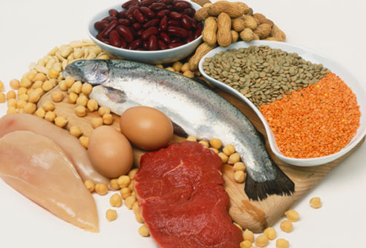

Slide 37
Phytic Acid and Oxalic Acid
They are found naturally in some plants, bind to calcium and can inhibit its absorption. Foods with high levels of oxalic acid include spinach, collard greens, sweet potatoes, rhubarb, and beans. Among the foods high in phytic acid are fiber-containing whole-grain products and wheat bran, beans, seeds, nuts, and soy isolates . The extent to which these compounds affect calcium absorption varies. Research shows, for example, that eating spinach and milk at the same time reduces absorption of the calcium in milk. In contrast, wheat products (with the exception of wheat bran) do not appear to lower calcium absorption .

Slide 38
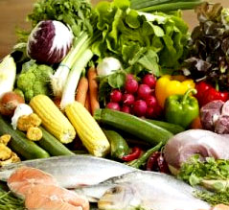

Slide 39
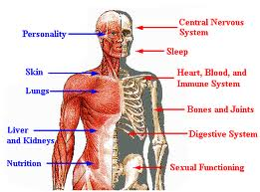
Alcohol intake: alcohol intake can affect calcium status by reducing its absorption and by inhibiting enzymes in the liver that help convert vitamin D to its active form . However, the amount of alcohol required to affect calcium status and whether moderate alcohol consumption is helpful or harmful to bone is unknown.

Slide 40
SODIUM
. A diet high in sodium may also interfere with calcium absorption. Some researchers believe that dietary sodium levels were extremely low in the past, compared to modern diets and increased sodium intake can result in increased calcium excretion .

Slide 41
EXERCIZE
Our sedentary life ways also interfere with mineralizing our bones. Our ancestors were probably much more active than we are. Impact stress on bone, as in walking and jogging, tends to increase production of calcitonin, which leads to increased deposition of calcium in the bones Exercise induced stress increases the cross sectional area and perhaps (equivocal data) bone mineral density

Slide 42
Tobacco smoking also appears to interfere with bone mineralization. Some researchers report that osteoblast formation is inhibited by nicotine . Study of animals given chronic doses of nicotine support this perspective by demonstrating reductions in bone mass .

Slide 43
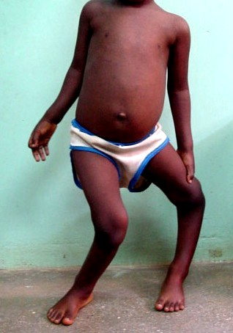
Deficiency Symptoms of calcium
The symptoms of calcium deficiency are:
Bowlegs, Pigeon Breast, and Knock-knees of children .
Cramp pains in legs .
Heart becomes irregular
Nerves become extremely irritable .

Slide 44
Poor sleep disorder .
Weakness in the bones .
Bone pain or tenderness .
Fractures with little or no trauma .
Loss of height (as much as 6 inches) over time .
Low back pain due to fractures of the spinal bones .
Neck pain due to fractures of the spinal bones .
Stooped posture or kyphosis, also called a "dowager's hump".

Slide 45
Prevalence of Osteoporosis
Osteoporosis effects millions of people worldwide. Due to better health care practices and improved lifestyle there is an increase in life expectancy. The prevalence of Osteoporosis and low bone mass is expected to increase worldwide with increased aging population. Approximately 10 million individuals over the age of 50 in USA have osteoporosis, among them 80% are women. Additional 33.6% individual over the age of 50 have Osteopenia and low bone mass density. Roughly 4 out of 10 white women aged 50 years or older in US will experience a hip, spine or wrist fracture.

Slide 46
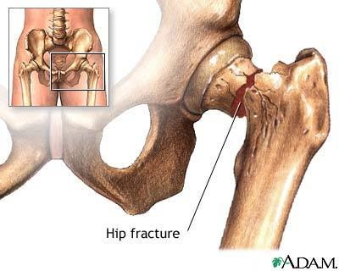

Slide 47
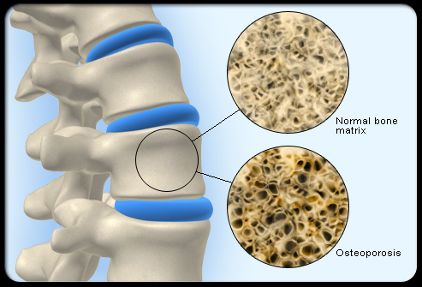
In Sweden Researchers found that increased life expectancy have increased life time risk of hip fracture in women from 14% to 23%.
Japanese data indicates the prevalence of Osteoporosis at the lumber spine to be increase remarkably. The hip fracture rate vary more than seven fold from one country to another with in Europe.

Slide 48
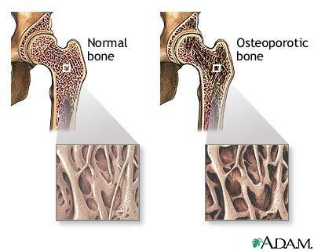
Osteoporosis is recognized as public health problem with improved morbidity and health care cost among elderly in developed country. There is scarcity of epidemiological data on magnitude of problem in India.
According to 2001 census, approximately 163 million Indian are above the age of 50. This number is expected to increase 230 million by 2015. Even conservative, estimates suggest that of there 20% of women would be Osteoporosis. And total affected population would be around 25 million. The fracture risk will be about 50 million by the 2015. This is very alarming situation for all of us .

Slide 49
Osteoporosis Risks and Risk Factors
Osteoporosis or 'porous bone' is a condition that can develop if bone is no longer replaced as quickly as it is removed. Bone density is influenced by factors such as heredity, sex, race, physical activity, overall health and most especially nutritional intake & absorption.
Even for those who do not actually fracture bones through falling, the health problems can be somewhat severe. A simple act of coughing or bending down can cause painful vertebral fractures that shorten height and lead to rounding of the spine known as dowager's hump.

Slide 50
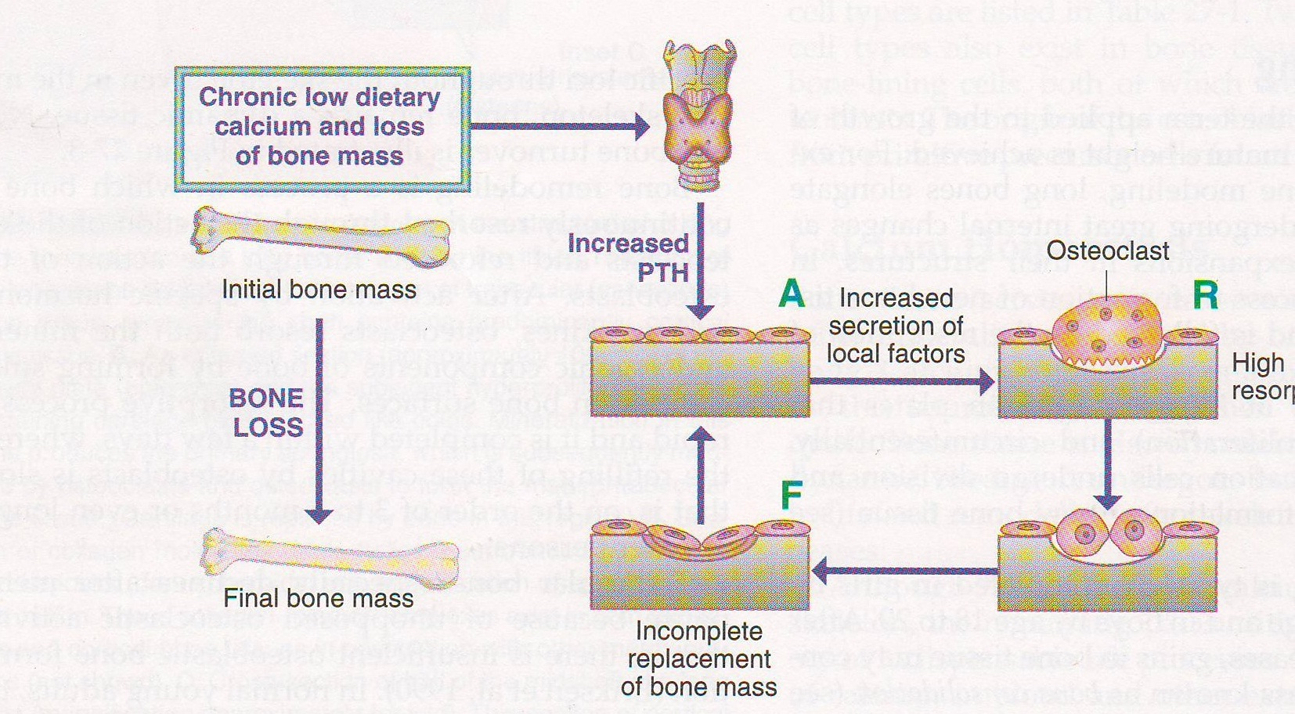

Slide 51
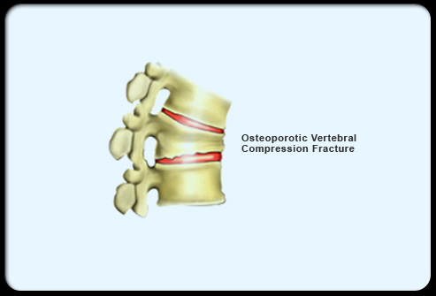

Slide 52
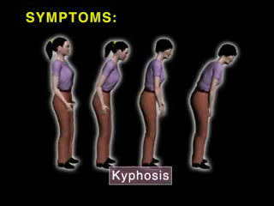


Slide 53
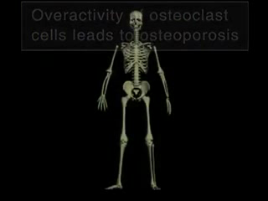
Types of Osteoporosis

Slide 54
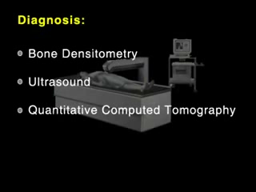
Diagnosis

Slide 55
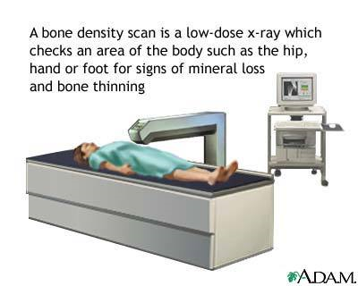
DXA

Slide 56
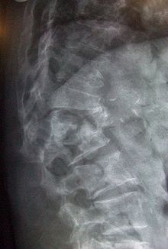
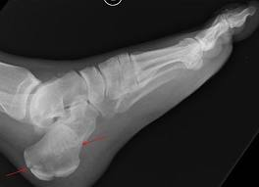
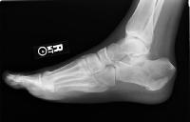
sonography

Slide 57
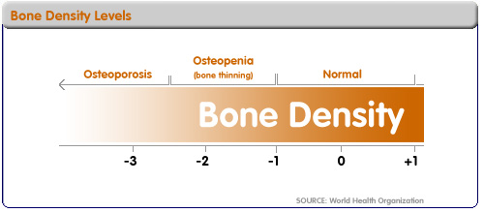
The World Health Organization has established the following diagnostic guidelines:
Tscore-1.0 or greater is "normal“.
T-score between -1.0 and -2.5 is "low bone mass" (or "Osteopenia").
T-score -2.5 or below is osteoporosis.

Slide 58
Clinical decision rule
A number of clinical decision rules have been created to predict the risk of osteoporotic fractures. The Q Fracture score was developed in 2009 and is based on age, BMI, smoking status, alcohol use, rheumatoid arthritis, cardiovascular disease, type 2 diabetes, asthma, use of tri cyclic antidepressants or corticosteroids, liver disease, and a history of falls in men. In women hormone replacement therapy, parental history of osteoporosis, gastrointestinal mal absorption, and menopausal symptoms are also taken into account. A website is available to help apply this score .

Slide 59
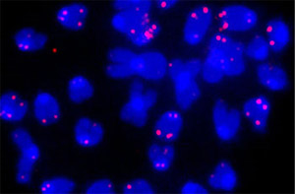
Color biomarker

Slide 60
RDA

Slide 61
DIETARY GUIDELINES
Soybean— The isoflavones in soybeans ,which function both as estrogen agonist and antioxidants in bone cells , May results in bone resorption .Population with low calcium Intakes from milk and dairy products ,such as Asians , may have some protection against osteoporosis and hip fractures when the intake of soy foods is high. Isoflavons such as genistein ,may act like selective estrogen receptors [SERMs]

Slide 62
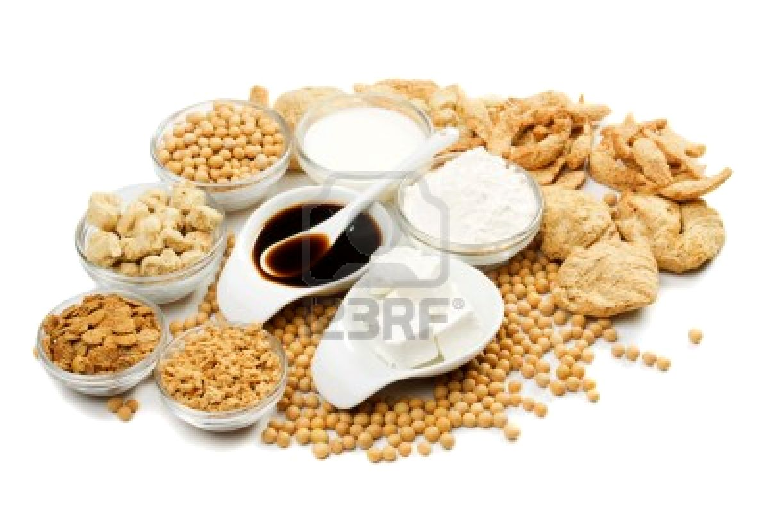

Slide 63
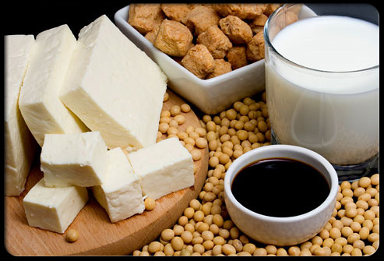

Slide 64
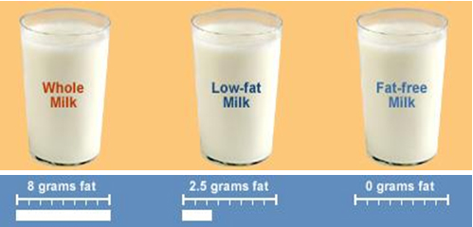
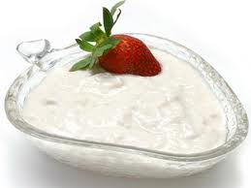
Milk and milk products – milk, yoghurt, cheese and buttermilk. One cup of milk, a 200g tub of yoghurt or 200ml of calcium fortified soymilk provides around 300mg calcium. Skimmed milks can provide larger amount of calcium 280mg per 200ml milk.

Slide 65
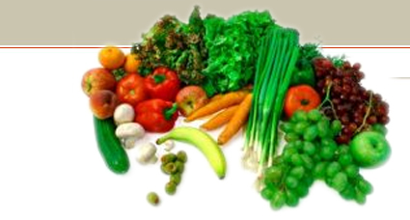

Leafy green vegetables – broccoli , drumstick leaves Chinese cabbage and fenugreek leaves . One cup of cooked spinach contains 10mg, although only five per cent of this may be absorbed. This is due to the high concentration of oxalate, a compound in spinach that reduces calcium absorption. By contrast, one cup of cooked broccoli contains about 45mg of calcium, but the absorption from broccoli is much higher at around 50–60 per cent.

Slide 66
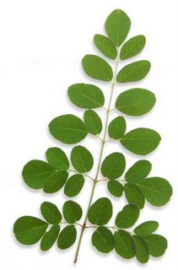
Simply a Natural Miracle
Moringa tree or also known as “Drumstick,” is an exceptionally nutritious tree with a variety of potential uses. The tree is slender with drooping branches, and grows up to 10 meters in height. The moringa tree grows very quickly. It comes into leaves at the end of the dry season, when other foods are the scarcest. Actually, the Moringa grows quickly in any tropical climate.

Slide 67
Nutritionally, drumstick leaves are of great value as sources of carotene, calcium, phosphorus and vitamin C. The leaves, flowers and fruits of drumstick which are used as vegetable have great nutritional value.
Nutritive Value of moringa oleifera leaves-
Food Value | Minerals and Vitamins
Moisture - 75.9% | Calcium - 440 mg
Protein - 6.7% | Phosphorus - 70 mg
Fat - 1.7% | Iron - 7 mg
 | Vitamin C - 220 mg
Fibre - 0.9% | Small amount of Vitamin B Complex
Minerals - 2.3% | * Values per 100 gm's edible portion
Carbohydrates - 12.57% | Calorific Value - 92

Slide 68
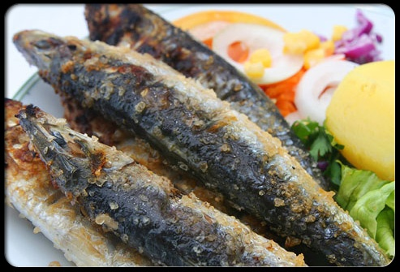
Fish – sardines and salmon (with bones). Half a cup of canned salmon contains 402 mg of calcium.

Slide 69
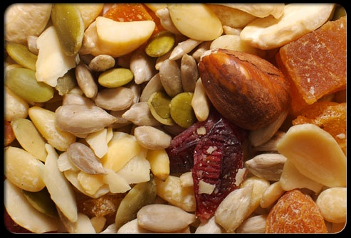
Nuts and seeds – brazil nuts, almonds and sesame seed paste (tahini). Fifteen almonds contain about 40mg of calcium.

Slide 70
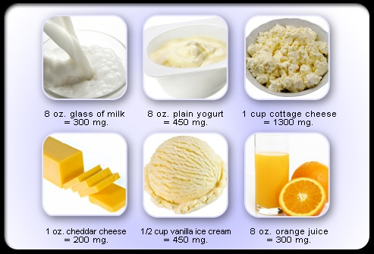
Calcium fortified foods
Including breakfast cereals, fruit juices and bread:
1 cup of calcium fortified breakfast cereal (40g) contains up to 200mg of calcium
½ cup of calcium fortified orange juice (100ml) contains up to 80mg of calcium
2 slices of bread (30g) provides 200mg of calcium.

Slide 71
Lifestyle can affect bone strength
Some of the factors that can reduce calcium in bones and lower bone density (weaken bones) include:
High salt diet
More than six drinks per day of caffeine-containing drinks – for example coffee, cola and tea (although tea has less caffeine)
Excessive alcohol intake
Very low body weight
Very high intakes of fibre (more than 50g per day, from wheat bran)
Low levels of physical activity.

Slide 72
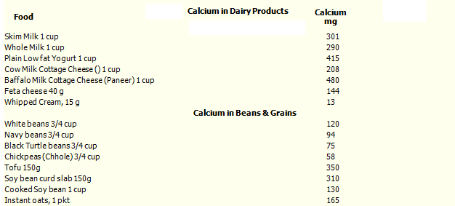

Slide 73
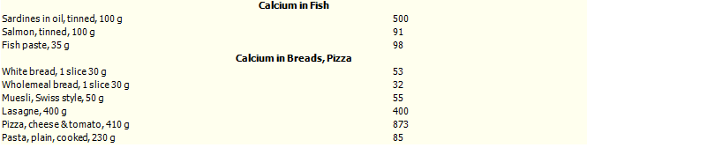

Slide 74
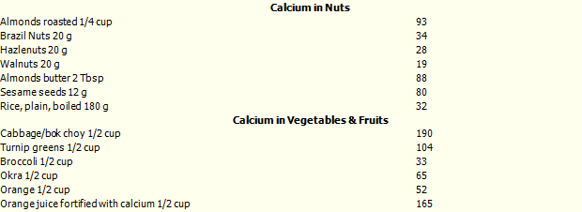

Slide 75
High-oxalate foods
Foods which contain oxalates or phytates, interfere with the body's ability to absorb calcium.
Fruits:
Blackberries ,blueberries, citrus peel Concord grapes Damson plums gooseberries ,raspberries.
red currant ,srhubarb , strawberries,
Vegetables: amaranth, beet leaves , cassava , collards
Leeks , okra, parsley purslane ,spinach ,sweet potatoes ,Swiss
chard
Beverages: beer berry juices coffee cola Ovaltine ®
Tea.
Other foods : almonds ,chocolate ,cocoa ,peanuts ,peanut butter pecans ,poppy seeds.

Slide 76
High-phytate foods
barley
beans
bran and wheat cereals
corn chips
nuts
oats
rice
rye bread
sesame seeds
soybean meal
wheat bran
wheat germ

Slide 77
For example, ½ cup of cooked spinach has 122 mg of calcium, but the bioavailability of that calcium is close to zero because spinach is high in oxalates. If you rely on vegetables as your source of calcium, you should choose low-oxalate vegetables more often, such as kale, broccoli, bok choy, mustard and turnip greens

Slide 78
How to retain calcium in healthy food?
Calcium is lost in cooking some foods even under the best conditions. To retain calcium:
Cook foods in a minimal amount of water.
Cook for the shortest possible time.
Some foods, such as orange juice, bread, and ready-to-eat cereals, are not normally good sources of calcium but may have had calcium added. Most instant-prepared cereals are fortified with calcium.
The amount of nutrient in a serving depends on the weight of the serving. For example, a cup of a cooked vegetable contains more calcium than a cup of the same vegetable served raw, because a serving of the cooked vegetable weighs more. Therefore, the cooked vegetable may appear on the list while the raw form does not.

Slide 79
Use low fat or fat free milk instead of water in recipes such as pancakes, mashed potatoes, pudding and instant, hot breakfast cereals.
Blend a fruit smoothie made with low fat or fat free yogurt for a great breakfast.
Sprinkle grated low fat or fat free cheese on salad, soup or pasta.
Choose low fat or fat free milk instead of carbonated soft drinks.
Serve raw fruits and vegetables with a low fat or fat free yogurt based dip.
Create a vegetable stir-fry and toss in diced calcium-set tofu.
Enjoy a parfait with fruit and low fat or fat free yogurt.
Complement your diet with calcium-fortified foods such as certain cereals, orange juice and soy beverages.

Slide 80
CALCIUM SUPPLEMENTS
Supplement | Elemental calcium by weight | Comment
Calcium carbonate | 40% | • Most commonly used • Less well absorbed in persons with decreased stomach acid (e.g., elderly or those on anti-acid medicines) • Natural preparations from oyster shell or bone meal may contain contaminants such as lead • Least expensive
Calcium citrate | 21% | • Better absorbed, especially by those with decreased stomach acid • May protect against kidney stones • More expensive.
Calcium phosphate | 38% or 31% | • Tricalcium or dicalcium phosphate • Used more in Europe • Absorption similar to calcium carbonate
Calcium gluconate | 9% | • Used intravenously for severe hypocalcemia • Well absorbed orally, but low content of elemental calcium • Very expensive
Calcium glubionate | 6.5% | • Available as syrup for children • Low content elemental calcium.
Calcium lactate | 13% | • Well absorbed, but low content elemental calcium.

Slide 81
The two main forms of calcium in supplements are carbonate and citrate. Calcium carbonate is more commonly available and is both inexpensive and convenient. Both the carbonate and citrate forms are similarly well absorbed, but individuals with reduced levels of stomach acid can absorb calcium citrate more easily. Other calcium forms in supplements or fortified foods include gluconate, lactate, and phosphate. Calcium citrate malate is a well-absorbed form of calcium found in some fortified juices .

Slide 82
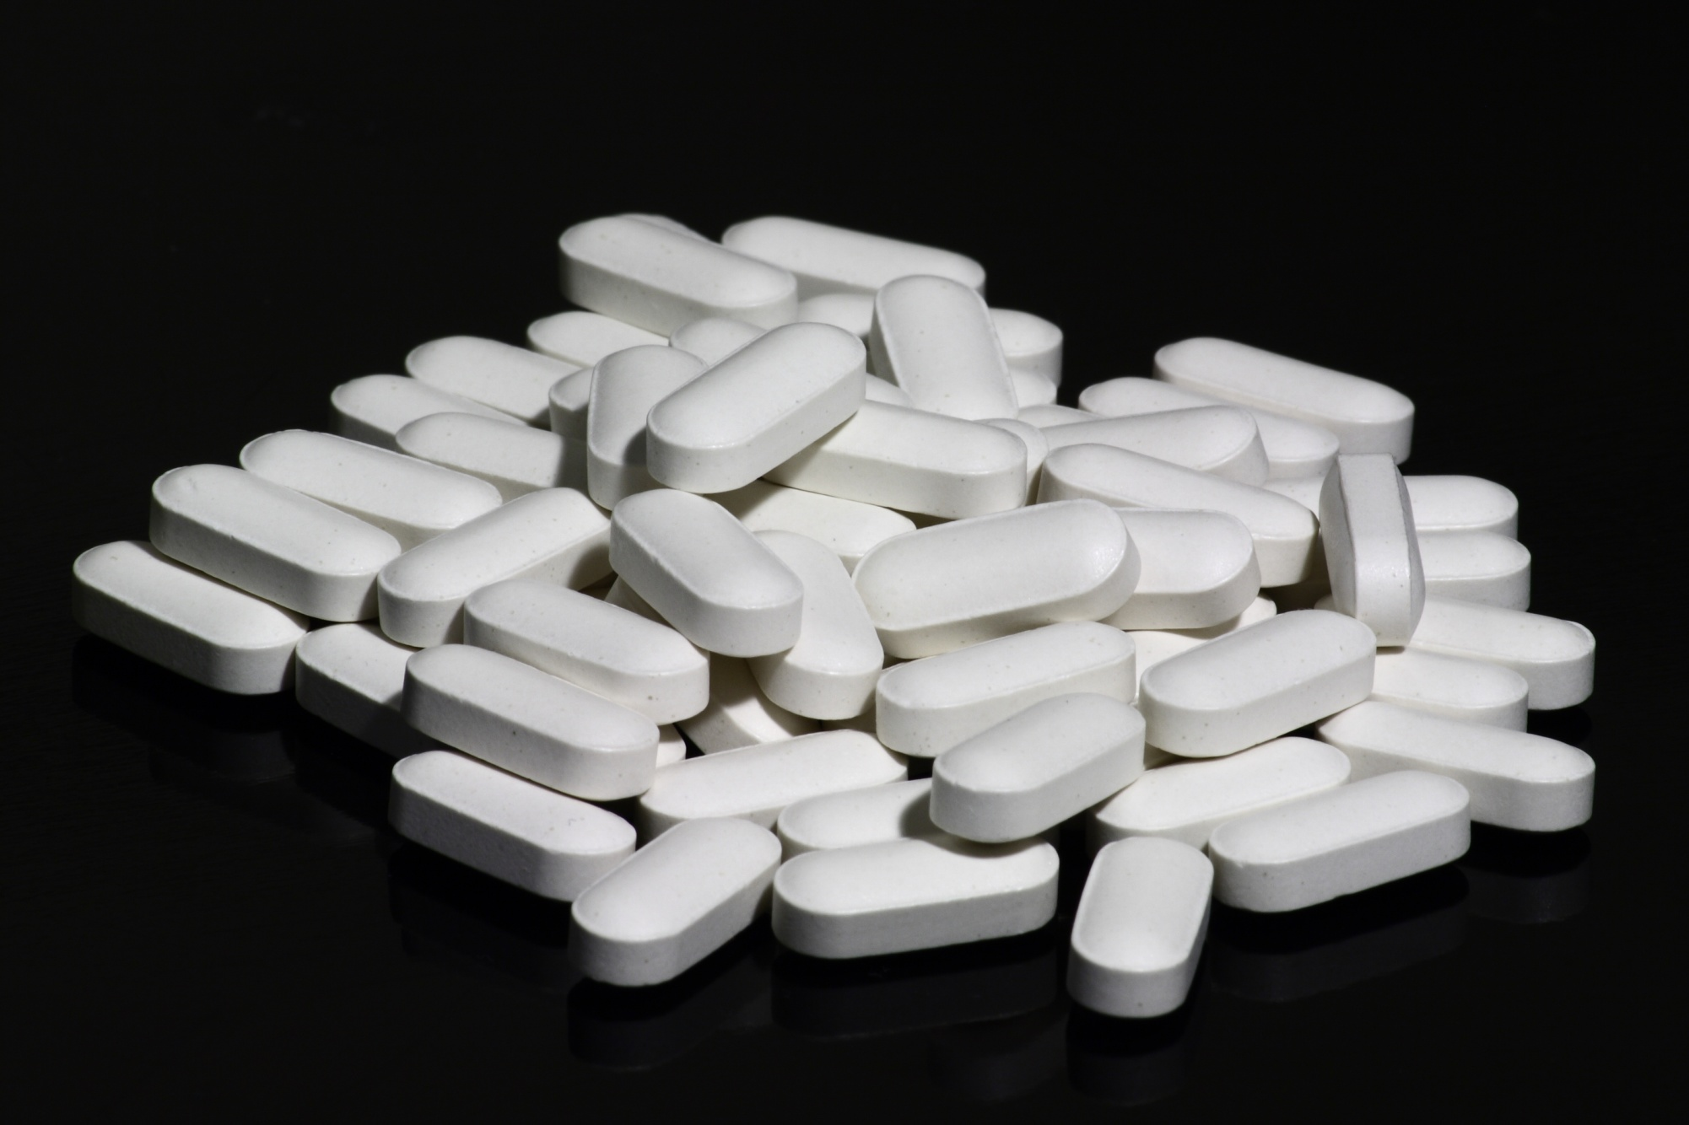

Slide 83

Thank You

