Slide 1
NRITYANJALI - 2019 BROCHURE

Slide 2
NRITYANJALI - 2019 from 14th to 17th September,2019
Kathak Dance Workshop - a tribute to Kathak Guru late Dr. P D Ashirvadam- was organised from 14th to 17th September 2019 by the department of Kathak dance in Association with Sree kala Manjari Kathak Sansthan Bilaspur under the supervision of renowned Kathak exponent and Guru Vidushi Vidya Hari Deshpande from Nashik, Maharashtra at Seminar hall Govt D.B. Girls P.G. College Raipur, Chhattisgarh.
Apart from the the students of Kathak dance, the students of various classes of the college like BA, BSc and BCom participated in the workshop. All the participants were divided divided into different groups after their short audition.The participants learnt the basic postures of Kathak and their nuances. They learnt types of tatkar and hand movements. They also learnt various thodas and Parans in TeenTaal. They learnt one bhajan and Tarana.On the last day of the workshop all the participants presented the compositions learnt in the workshop and and got corrected by the Guru.

Slide 3
NRITYANJALI - 2019 from 14th to 17th September,2019

Slide 4
LIST OF PARTICIPANTS
S.No. | NAME | CLASS
1 | Shriansha Verma | 1st year
2 | Leena Chandrakar | 1st year
3 | Richa Chandrakar | 1st year
4 | Vandana Sahu | 1st year
5 | Aarju Khan | 1st year
6 | Madhulika Mishra | 1st year
7 | Jagrity thakur | 1st year
8 | Pooja Baghel | 1st year
9 | Triveni Bandh | 1st year
10 | Dharini Soni | 1st year
11 | Gitanajali Dhruw | 1st year
12 | Vaishanvi Chitriv | 1st year
13 | Aakancha sharma | 1st year
14 | Ke. Priyanka Aachari | 1st year
15 | Anupma Bhagat | 1st year
16 | Pooja Sahu | 1st year
17 | Shrishit Maheshwari | 1st year
18 | Anjali Sahu | 1st year
19 | Venu Dhruw | 1st year
20 | Jhansi Sahu | 1st year
21 | Hemshwari Sahu | 1st year
22 | Manisha Rajat | 1st year
23 | Reshmi Dhruw | 1st year
24 | Kusum Banjare | 1st year
25 | Khushboo Deshlahare | 1st year
26 | Bogesha Sonkar | 1st year
27 | Deepa Dhangar | 2nd Year
28 | Damini Dewanagan | 2nd Year

Slide 5
29 | Grishma Agrawal | 2nd Year
30 | Nargish Bano | 2nd Year
31 | Nilofar Bano | 2nd Year
32 | Anmol Pseriya | 2nd Year
33 | Devi Sahu | 2nd Year
34 | Janki Dewangan | 2nd Year
35 | Bhavna Aoushar | 2nd Year
36 | Savita Kuree | 2nd Year
37 | Rani Dhiwar | 2nd Year
38 | Vidhaya Bharti | 2nd Year
39 | Adayasha Patnayak | 2nd Year
40 | Vandana Verma | 2nd Year
41 | Shushma Sahu | 2nd Year
42 | Sanjana Patel | 2nd Year
43 | Ojashavi Beragi | 2nd Year
44 | Satybhama Jandge | 2nd Year
45 | Payal Maithil | 2nd Year
46 | Kanchan Bais | 2nd Year
47 | Renu Sapha | 2nd Year
48 | Premlata Sahu | 2nd Year
49 | Vibha Thakur | 2nd Year
50 | Swati Yadav | 2nd Year
51 | Rameshwari Sahu | 2nd Year
52 | Jaya Manikpuri | 2nd Year
53 | Bhavna Aoushar | 3rd Year
54 | Rani Dhiwar | 3rd Year
55 | Hemlata Dhruw | 3rd Year
56 | Chandani Roy Chowdhury | Senior Student
57 | Pranam Tiwari | Senior Student
58 | Swarna Sarkar | Senior Student
59 | Pratika Bahre | Senior Student
60 | Priti Singh | Senior Student
61 | Kbir Khatri | Senior Student
62 | Aparrna Ash | Senior Student
63 | Chaya Jain | Senior Student
64 | Himari Khande | Senior Student

Slide 6
65 | Chameli Jaltare | Senior Student
66 | Priney | Senior Student
67 | Deshakshi | Senior Student
68 | Pranam Tiwari | Senior Student
69 | Swarna Sarkar | Senior Student
70 | Pratika Behre | Senior Student
71 | Chandani Roy | Senior Student
72 | Vinal Pitroda | Senior Student
73 | Prachi Nigam | Senior Student
74 | Preeti Kurrey | Senior Student
75 | Bhagini Sonkar | Senior Student
76 | Gargita Datta | Senior Student
77 | Tejram Patel | Senior Student
78 | Ragini Pandey | Professor
79 | Kiran Dewangan | Professor
80 | Manish Mishra | Professor
81 | Rama Sarojini | Professor
82 | Arita Dixit | Professor
83 | Kalpana Mishra | Professor
84 | Jaya Dixit | Professor
85 | Priti Kansara | Professor
86 | Ritu Marwah | Professor
87 | Alka Verma | Professor
88 | Maya Shedpune | Professor
89 | Puahpa Tiwari | Professor
90 | Shradha Girolker | Professor
91 | Priti Sharma | Professor
92 | Priya Dewangan | Professor
93 | Swati Shriwastav | Professor
94 | Jagriti Sonkar | Professor
95 | Moneeshu Mahapatra | Professor
96 | Madhu Shriwastav | Professor

Slide 7
LIST OF PARTICIPANTS
S.No. | NAME | CLASS
1 | Shriansha Verma | 1st year
2 | Leena Chandrakar | 1st year
3 | Richa Chandrakar | 1st year
4 | Vandana Sahu | 1st year
5 | Aarju Khan | 1st year
6 | Madhulika Mishra | 1st year
7 | Jagrity thakur | 1st year
8 | Pooja Baghel | 1st year
9 | Triveni Bandh | 1st year
10 | Dharini Soni | 1st year
11 | Gitanajali Dhruw | 1st year
12 | Vaishanvi Chitriv | 1st year
13 | Aakancha sharma | 1st year
14 | Ke. Priyanka Aachari | 1st year
15 | Anupma Bhagat | 1st year
16 | Pooja Sahu | 1st year
17 | Shrishit Maheshwari | 1st year
18 | Anjali Sahu | 1st year
19 | Venu Dhruw | 1st year
20 | Jhansi Sahu | 1st year
21 | Hemshwari Sahu | 1st year
22 | Manisha Rajat | 1st year
23 | Reshmi Dhruw | 1st year
24 | Kusum Banjare | 1st year
25 | Khushboo Deshlahare | 1st year
26 | Bogesha Sonkar | 1st year
27 | Deepa Dhangar | 2nd Year
28 | Damini Dewanagan | 2nd Year
29 | Grishma Agrawal | 2nd Year
30 | Nargish Bano | 2nd Year
31 | Nilofar Bano | 2nd Year
32 | Anmol Pseriya | 2nd Year
33 | Devi Sahu | 2nd Year
34 | Janki Dewangan | 2nd Year
35 | Bhavna Aoushar | 2nd Year
36 | Savita Kuree | 2nd Year
37 | Rani Dhiwar | 2nd Year
38 | Vidhaya Bharti | 2nd Year
39 | Adayasha Patnayak | 2nd Year
40 | Vandana Verma | 2nd Year
41 | Shushma Sahu | 2nd Year
42 | Sanjana Patel | 2nd Year
43 | Ojashavi Beragi | 2nd Year
44 | Satybhama Jandge | 2nd Year
45 | Payal Maithil | 2nd Year
46 | Kanchan Bais | 2nd Year
47 | Renu Sapha | 2nd Year
48 | Premlata Sahu | 2nd Year
49 | Vibha Thakur | 2nd Year
50 | Swati Yadav | 2nd Year
51 | Rameshwari Sahu | 2nd Year
52 | Jaya Manikpuri | 2nd Year
53 | Bhavna Aoushar | 3rd Year
54 | Rani Dhiwar | 3rd Year
55 | Hemlata Dhruw | 3rd Year
56 | Chandani Roy Chowdhury | Senior Student
57 | Pranam Tiwari | Senior Student
58 | Swarna Sarkar | Senior Student
59 | Pratika Bahre | Senior Student
60 | Priti Singh | Senior Student
61 | Kbir Khatri | Senior Student
62 | Aparrna Ash | Senior Student
63 | Chaya Jain | Senior Student
64 | Himari Khande | Senior Student
65 | Chameli Jaltare | Senior Student
66 | Priney | Senior Student
67 | Deshakshi | Senior Student
68 | Pranam Tiwari | Senior Student
69 | Swarna Sarkar | Senior Student
70 | Pratika Behre | Senior Student
71 | Chandani Roy | Senior Student
72 | Vinal Pitroda | Senior Student
73 | Prachi Nigam | Senior Student
74 | Preeti Kurrey | Senior Student
75 | Bhagini Sonkar | Senior Student
76 | Gargita Datta | Senior Student
77 | Tejram Patel | Senior Student
78 | Ragini Pandey | Professor
79 | Kiran Dewangan | Professor
80 | Manish Mishra | Professor
81 | Rama Sarojini | Professor
82 | Arita Dixit | Professor
83 | Kalpana Mishra | Professor
84 | Jaya Dixit | Professor
85 | Priti Kansara | Professor
86 | Ritu Marwah | Professor
87 | Alka Verma | Professor
88 | Maya Shedpune | Professor
89 | Puahpa Tiwari | Professor
90 | Shradha Girolker | Professor
91 | Priti Sharma | Professor
92 | Priya Dewangan | Professor
93 | Swati Shriwastav | Professor
94 | Jagriti Sonkar | Professor
95 | Moneeshu Mahapatra | Professor
96 | Madhu Shriwastav | Professor

Slide 8
NRITYANJALI - 2019 from 14th to 17th September,2019 Certificate for the Participants

Slide 9
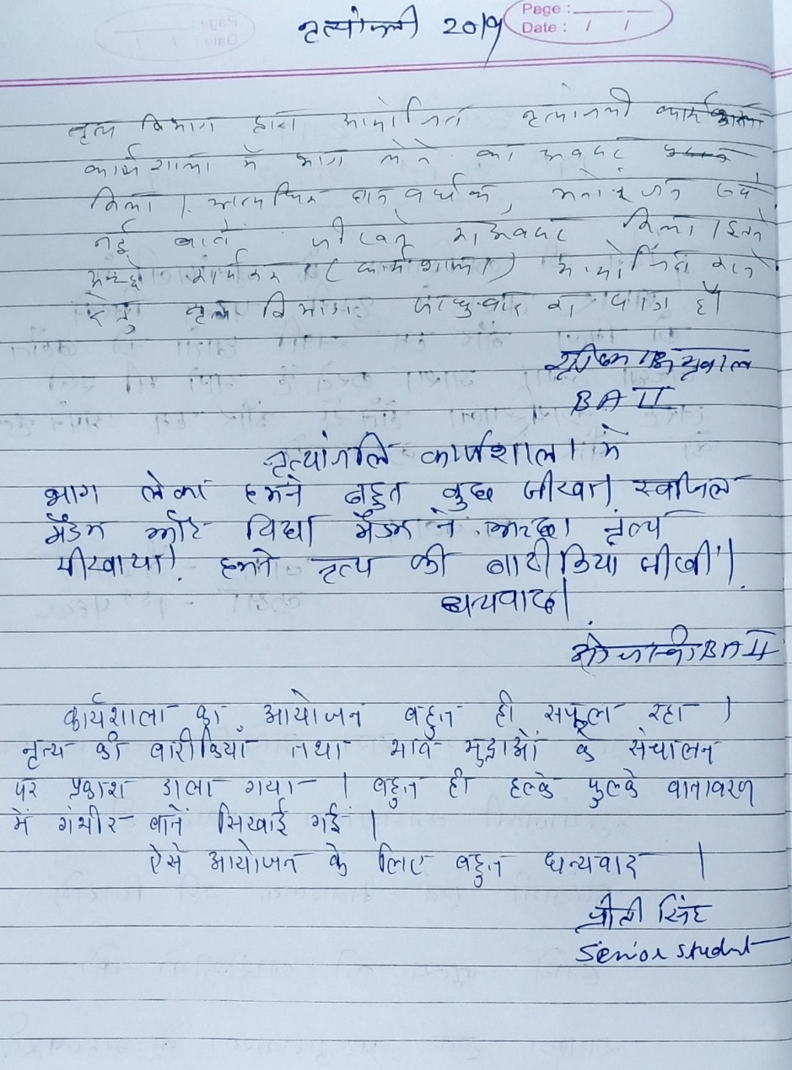
Feedback by the Participants

Slide 10
Feedback by the Participants

Slide 11
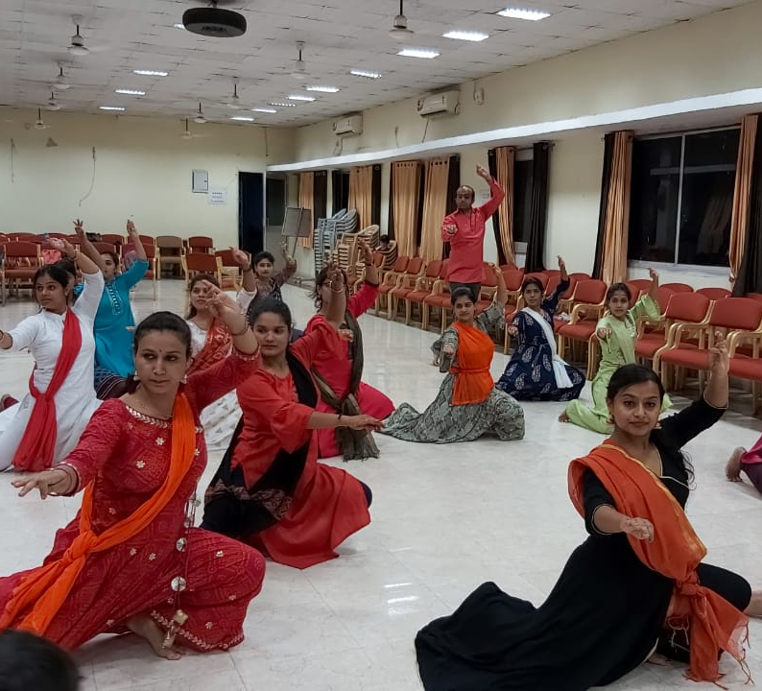
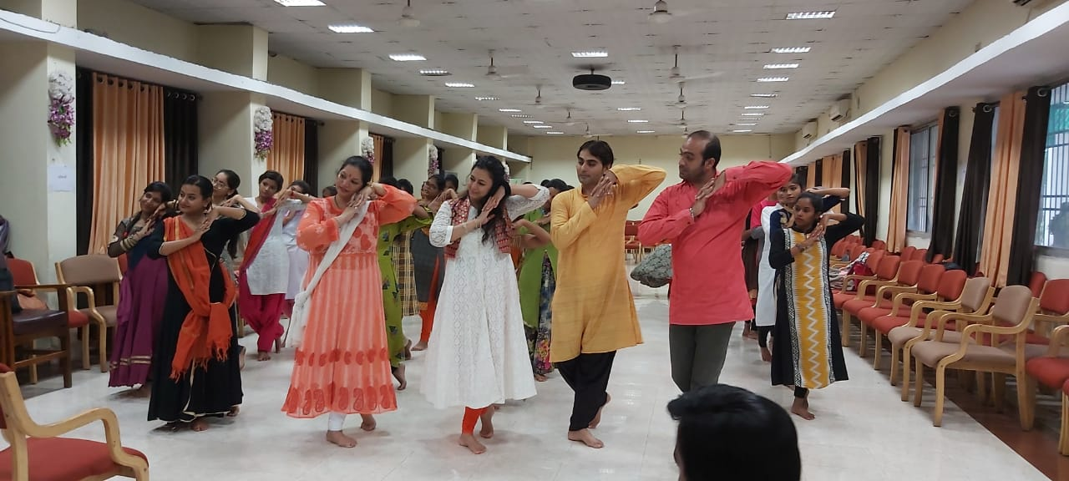
NRITYANJALI – 2019 Photos

Slide 12
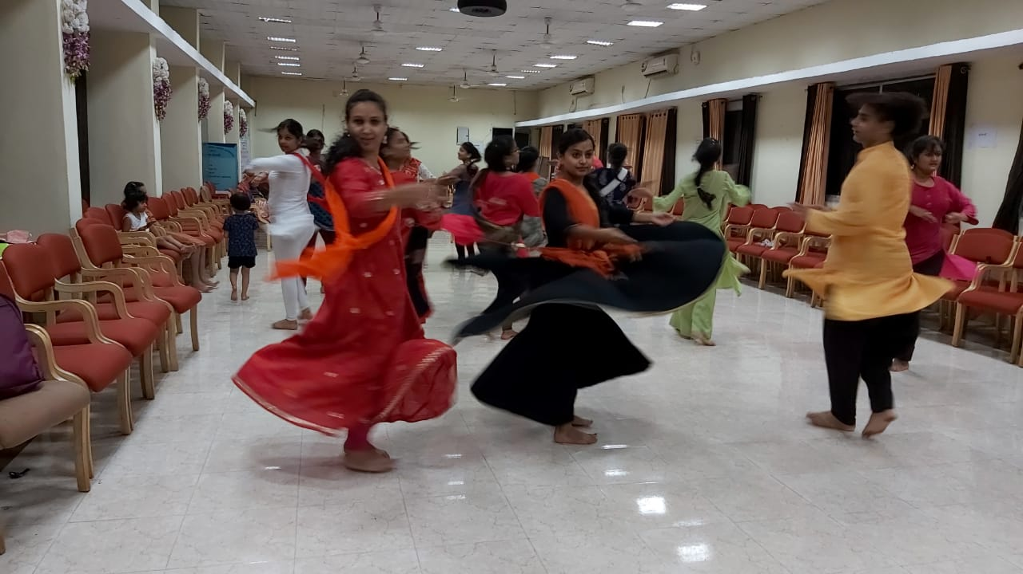
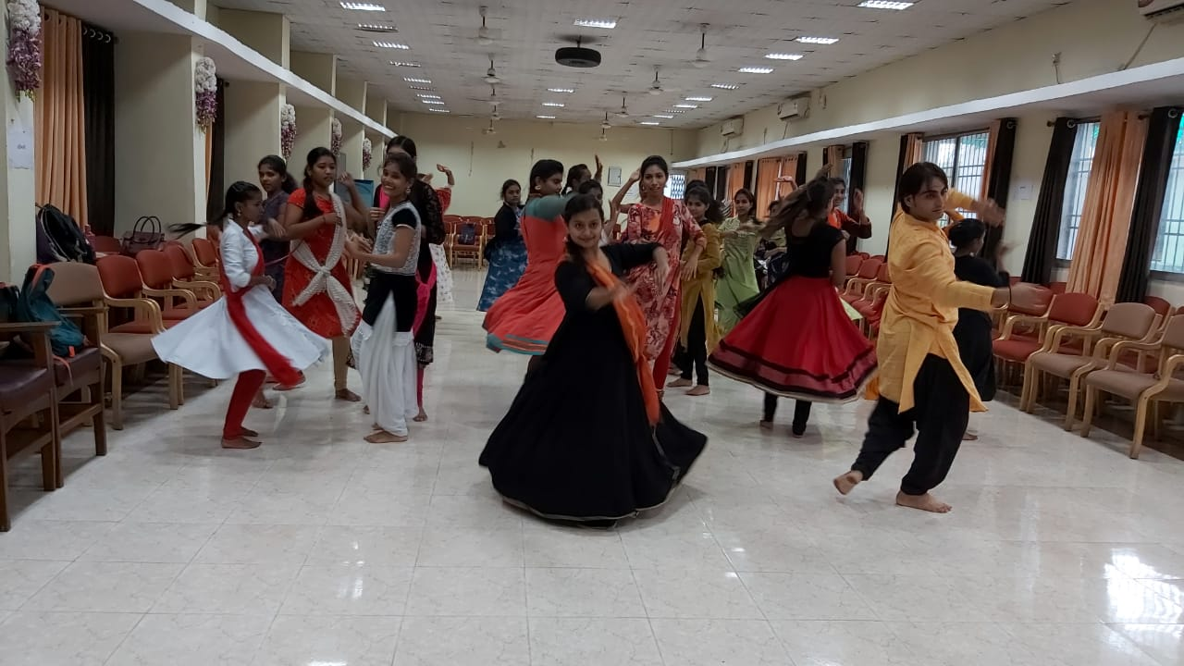
NRITYANJALI – 2019 Photos

Slide 13
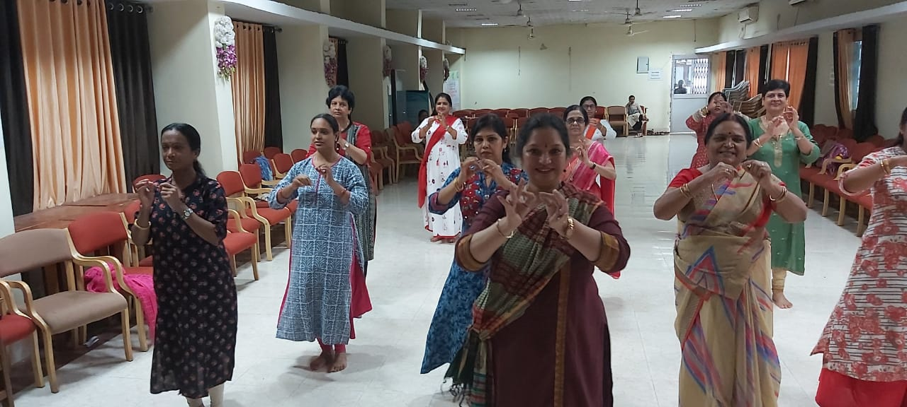
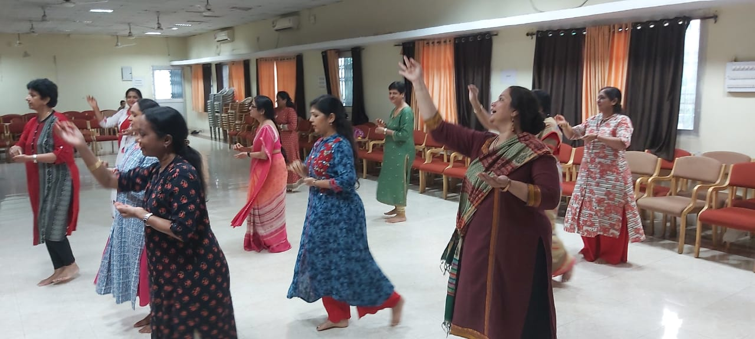
NRITYANJALI – 2019 Photos

Slide 14
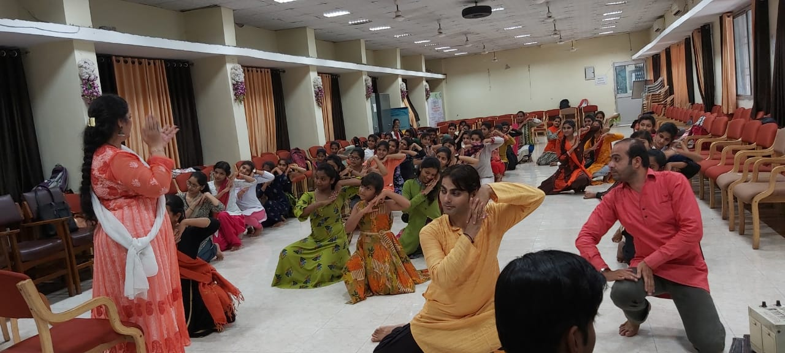
NRITYANJALI – 2019 Photos

Slide 15
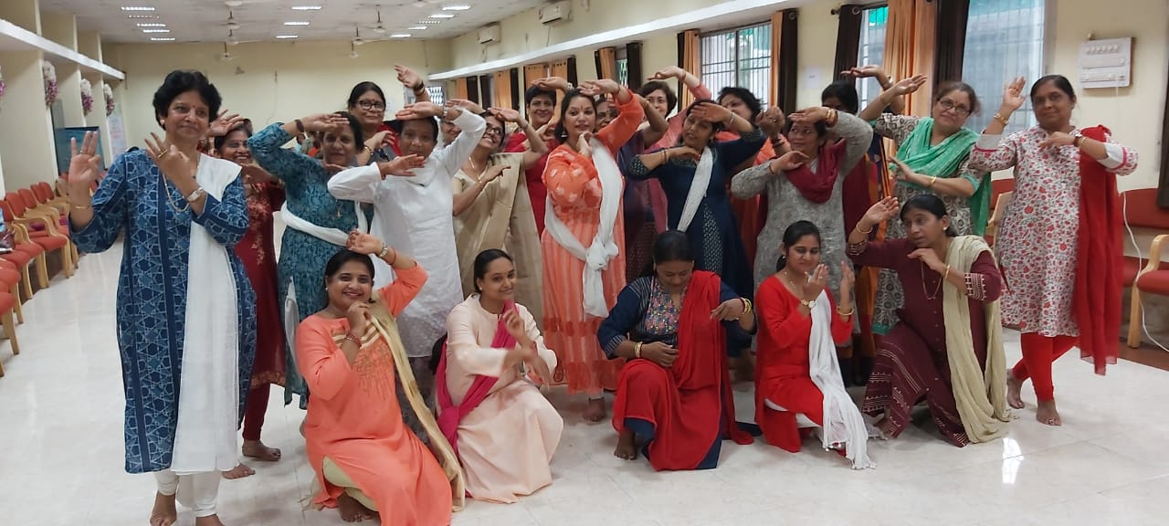
NRITYANJALI – 2019 Photos

Slide 16
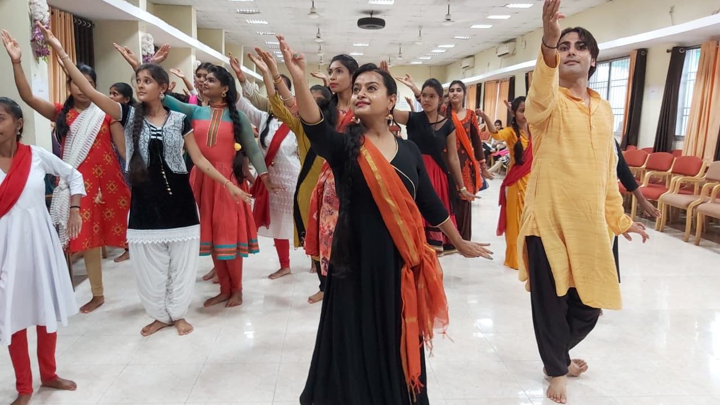
NRITYANJALI – 2019 Photos

Slide 17
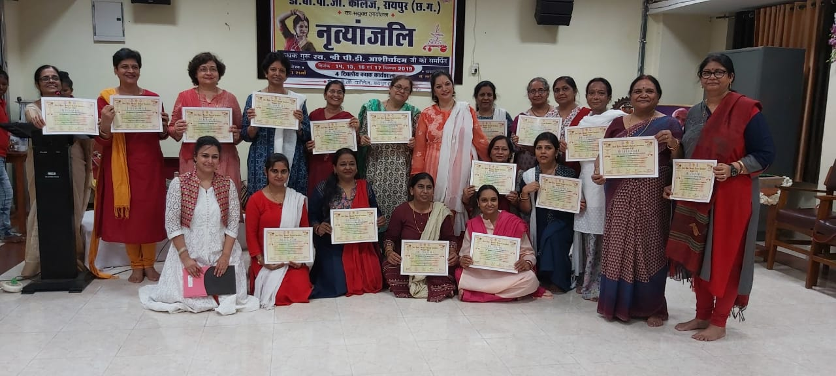
NRITYANJALI – 2019 Photos

Slide 18
NRITYANJALI – 2019 Press coverage

Slide 19
NRITYANJALI – 2019 Press coverage

